Slide 1
The Nebraska LEGISLATIVE PROCESS
J. Ritchie Morrow
NeASFAA Spring Conference
March 27, 2025

Slide 2
History
1930’s – Dust Bowl affected State Finances
George Norris – Senator from McCook
  Bicameral System – Modeled after British Parliament
    “The constitution of our various states are built upon the idea that there is but one class. If this be true, there is no sense or reason in having the same thing done twice, especially if it is to be done by two bodies of men elected in the same way and having the same jurisdiction.”
  60,000 Nebraska residents Signed Petition
  286,086 for; 193,152 Against

Slide 3
History – cont.
Jan 5, 1937 – first day of the Nebraska Unicameral
  Senators – 133 in bicameral to 43 in unicameral
  More Efficient
    Last Bicameral – 110 days, passed 192 bills, Cost $202,593
    First Unicameral – 98 days, Passed 214 bills, Cost $103,445

Slide 4
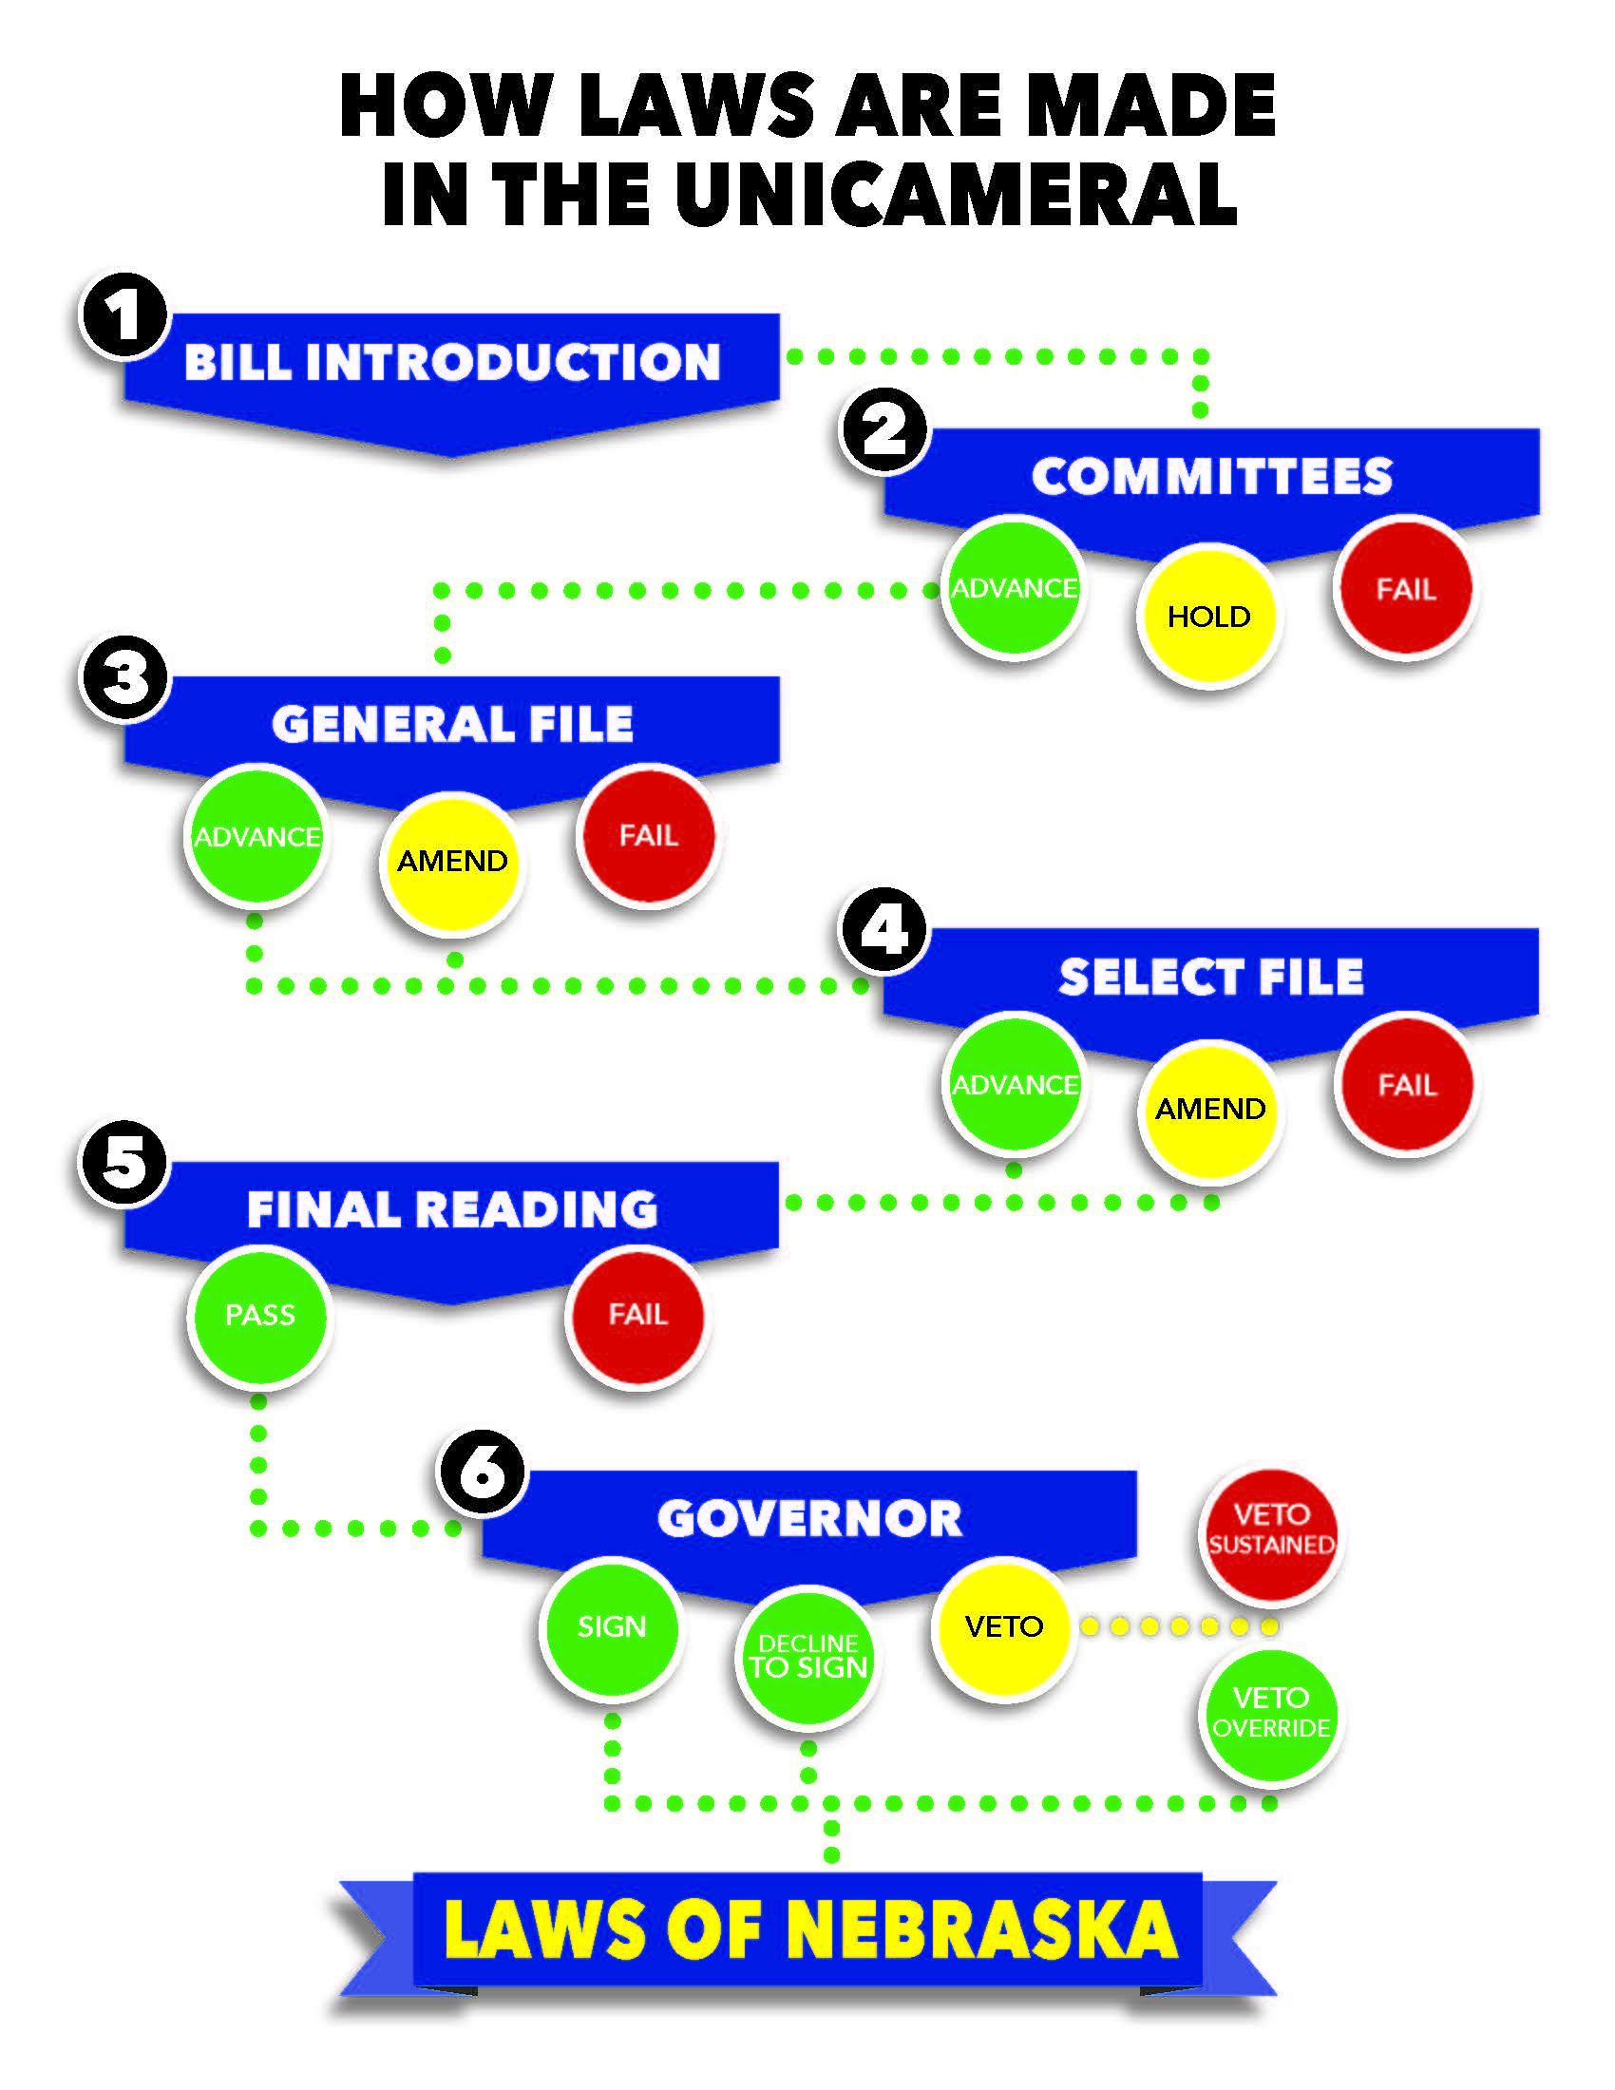

Slide 5
Bill Introduction
Idea
  Suggested by Anyone – citizen, interest groups, state agencies, Senators, Governor
Submitted to Legislative Research Office
Submitted to Bill Drafting
  Transforms Idea into Proper Legal Form
  Can contain only one subject

Slide 6
Bill Introduction – cont.
Introduction
  First 10-days of each Session
  Submitted to Clerk of the Legislature
    Bill Read into record and Assigned number (LB or LR)
  Fiscal Impact? ‘A’ Bill
    Legislative Fiscal Office, Governor’s Budget Office, Affected State Agency
Assigned to Reference Committee
  Determine Bill Assignment

Slide 7
Committee
14 Committees
Public Hearing
  Pro, Con, Neutral
  Time Limit
Executive Session
  Send to General File
  Postpone
  No Action

Slide 8
General File
Introduced to Full Legislature
  Introducing Senator Explains Bill – 10 minutes
  Debate and Introduce Amendments
  5 minute limit; Can Speak 3 Times
  Can yield time
Majority (25 Votes) to Approve Amendments and Advance

Slide 9
Enrollment and Review
Referred to as E&R
  Amendments Officially Attached
  Technical & Grammatical Checking

Slide 10
Select File
Second Round
  Debate and Introduce Amendments
  5 minute limit; Can Speak 3 Times
  Can yield time
Majority (25 Votes) to Approve Amendments and Advance

Slide 11
Enrollment and Review
Referred to as E&R
  Amendments Officially Attached
  Technical & Grammatical Checking

Slide 12
Final Reading
Clerk Reads Aloud
  30 Votes can Waive
No Amendments or Debate
  May be Returned to Select File
Votes to Approve
  CA on General Election – 30
  CA on Primary or Special Election – 40
  Emergency (E) Clause – 33
  All Others - 25

Slide 13
Governor
Has Five Days (not Counting Sundays)
  Sign or No Action – Bill Becomes Law
  Veto
    Full Bill
    Line-item in appropriations bills
  Legislature Override
    30 Votes

Slide 14
Terms
Biennium – Two Year Period
  Legislature
  Budget
Bracket – Delay a Bill
Call of the House – Compel Attendance
  Majority of Those Voting
Cloture – Cease Debate and Immediately Vote

Slide 15
Terms – cont.
Engrossment/Correctly Engrossed – ready for Final Readying with all Amendments
Executive board – overseas internal affairs of the legislature
Germane – relevant to topic of bill
Indefinitely Postpone (IPP) – suspend all activity on bill
Major Proposal – precedence over all bills
  Designated by speaker with 2/3 approval by executive board
  Up to 5 bills

Slide 16
Terms – cont.
Priority Bill – considered ahead of other bills
  Senator – 1
  Committee – 2
  Speaker – 25
Sine die – full legislature finished for the year
Special session – called for a specific purpose
  Governor or 33 votes of the legislature

Slide 17
Questions?

